Slide 1

Back to the basics: Strategy & Template Method.
Explaining design patterns with real life examples

Slide 2

About me
I’m a software engineer with almost 20 years of experience, primarily working with Microsoft technologies like .NET Web API, MVC, WPF, .NET Core and SQL Server.
My work has primarily centered on backend development, though I’ve also worked with frontend frameworks like Angular and Knockout JS when needed.
Over the years, I’ve contributed to projects across several industries, including energy, telecommunications, banking, advertising, and healthcare.
I joined Endava in the autumn of 2024.
In my free time, I enjoy reading and trying to play guitar. ion-alexandru.vladila@endava.com
Senior Developer
Alex Vladila

Slide 3

Target audience
Developers
Technical leads

Slide 4
Introduction
What are design patterns?
In software engineering, a design pattern is a repeatable solution to a commonly occurring problem in software design.
The pattern is not a specific piece of code, but a general concept for solving a particular problem (that can be used in many different situations).

Slide 5
Introduction
Categories of design patterns
Creational patterns: provide object creation mechanisms that increase flexibility and reuse of existing code.
Structural patterns: explain how to assemble classes into structures, while keeping these structures flexible.
Behavioral patterns: provide solution for the better interaction between objects, lose coupling, and flexibility to extend easily

Slide 6

Introduction
Creational patterns
Singleton – Ensures a class has only one instance and provides a global point of access to it.
Factory Method – Uses factory methods to deal with the problem of creating objects without having to specify their exact classes.
Abstract Factory – Provides an interface for creating families of related or dependent objects without specifying their concrete classes.
Builder – Separates the construction of a complex object from its representation.
Prototype – Creates new objects by copying an existing object (a prototype)

Slide 7
Introduction
Structural patterns
Adapter – Allows incompatible interfaces to work together.
Bridge – Separates an object’s abstraction from its implementation so the two can vary independently.
Composite – Composes objects into tree structures to represent part-whole hierarchies.
Decorator – Adds responsibilities to objects dynamically without changing their code.
Facade – Provides a unified interface to a set of interfaces in a subsystem.
Flyweight – Reduces memory usage by sharing common parts of objects instead of creating duplicates.
Proxy – Provides a substitute or placeholder to control access to another object

Slide 8

Introduction
Behavioral patterns
Chain of Responsibility – Passes a request along a chain of handlers until one handles it.
Command –Encapsulates a request as an object, allowing for parameterization and queuing.
Interpreter – Defines a grammar for a language and provides an interpreter to process it.
Iterator –Provides a way to access elements of a collection without exposing its structure.
Mediator – Centralizes communication between objects to reduce direct dependencies.
Memento – Captures and restores an object’s internal state without violating encapsulation.
Observer –Allows objects to be notified when another object changes state.
State –Allows an object to alter its behavior when its internal state changes.
Strategy – Defines a family of algorithms and makes them interchangeable.
Template Method – Defines the skeleton of an algorithm, deferring some steps to subclasses.
Visitor –Separates an algorithm from the objects it operates on

Slide 9
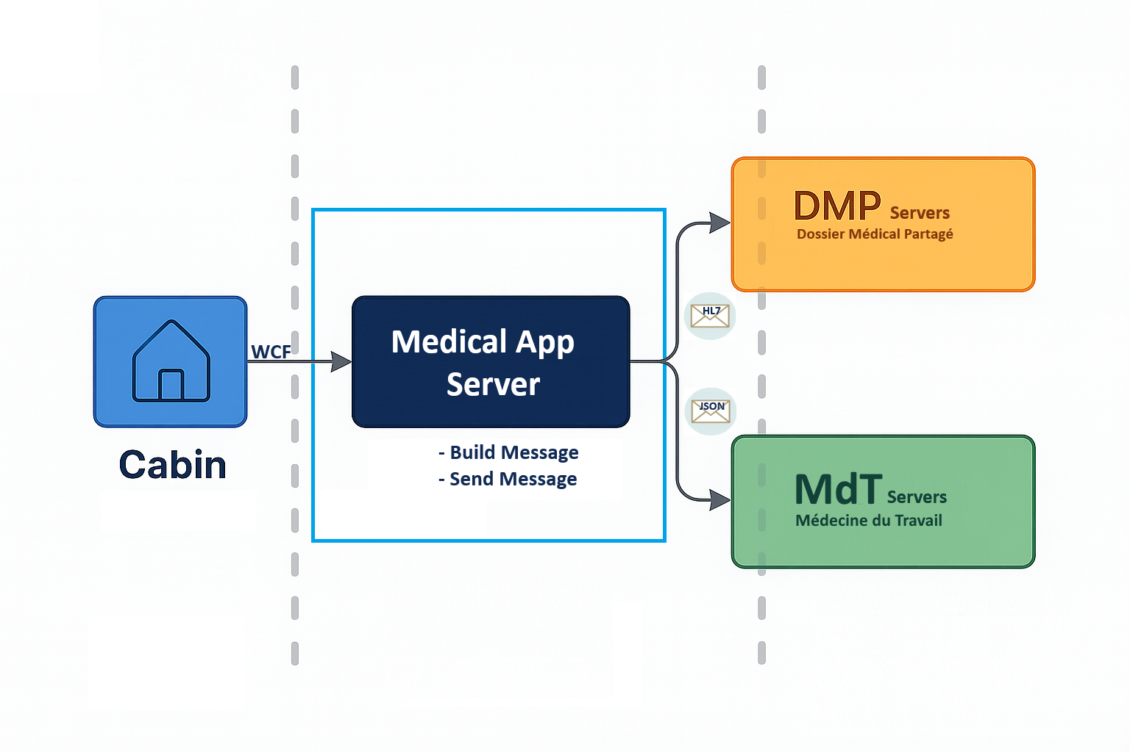
Real life context

Slide 10
Strategy
Definition
The Strategy design pattern is a behavioral pattern that allows you to define a family of algorithms, encapsulate each one, and make them interchangeable at runtime. It lets you vary an algorithm’s behavior independently from the code that uses it, promoting flexibility and reducing tight coupling.

Slide 11
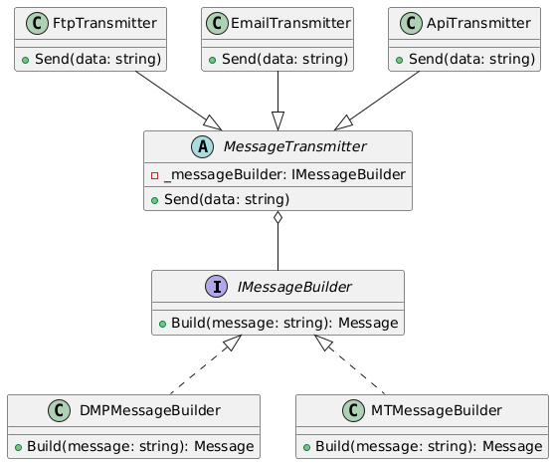
Before Strategy

Slide 12
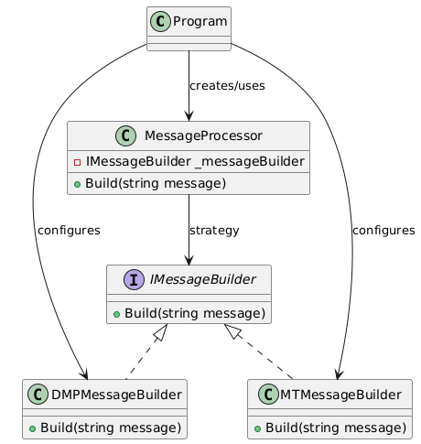
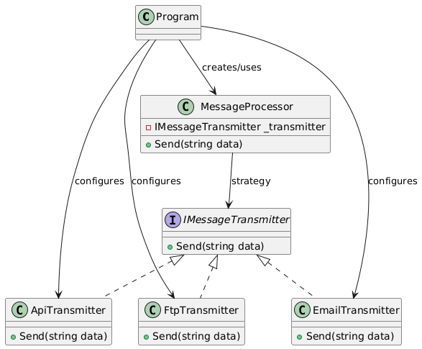
Implementing Strategy
Strategy 1
Strategy 2

Slide 13
Strategy Pros & Cons
✔️ Promotes Single Responsibility & Open/Closed Principles
✔️ Allows you to easily change implementations at runtime
✔️ Encapsulates behavior
✔️ Easier to test and maintain
❌ The client (class that contains the context) must be aware of the available strategies
❌ May overcomplicate simple logic, if not used properly

Slide 14
Strategy
Implementation
https://github.com/alexandruvladila/EndavaDesignPattern
StrategyDesignPattern.After

Slide 15
Template Method
Definition
The Template Method design pattern defines the skeleton of an algorithm in a base class, allowing subclasses to override specific steps without changing the overall structure.

Slide 16
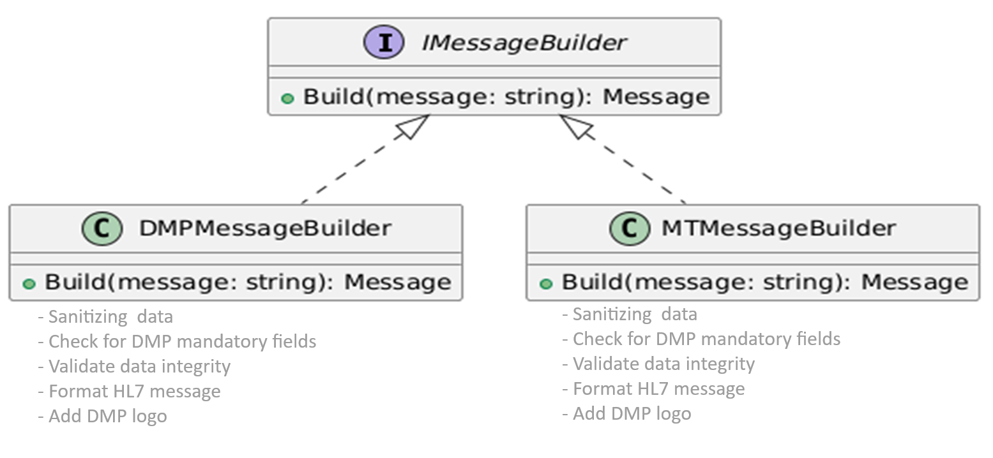
Before Template Method

Slide 17
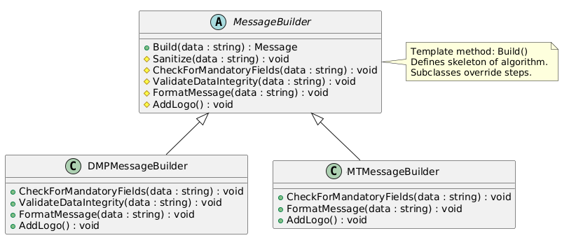
Implementing Template Method

Slide 18
Template Method Pros & Cons
✔️ Promotes Code Reuse
✔️ Consistent Algorithm Structure
✔️ Supports the Open/Closed Principle
❌ Tight Coupling Between Base and Subclasses
❌ Can violate Liskov principle

Slide 19
Template Method
Implementation
https://github.com/alexandruvladila/EndavaDesignPattern
TemplateMethodDesignPattern.After

Slide 20
Q & A

Slide 21
Bye

